Slide 1


SDN-[ITDX 33]
SDN-Inspired Secure Campus Network Design using Cisco Packet Tracer
Noorul Hassan -[210081601045] Muhammed Thahir-[210081601039]
)

Slide 2

Objective
Design a secure campus network for IT department
Apply SDN-inspired centralized architecture concept
Implement VLAN segmentation
Enable inter-VLAN communication using RIP
Simulate and verify connectivity using Cisco Packet Tracer

Slide 3


Abstract
This project presents a secure campus network topology for the IT department. Designed and simulated using Cisco Packet Tracer, inspired by Software Defined Networking (SDN) architectural concepts. The network includes multiple IT labs, administrative offices, and a conference hall, all segmented using VLANs and interconnected through Router-on-a-Stick configuration with RIP as the dynamic routing protocol. The design demonstrates centralized monitoring, secure subnet isolation, and verified inter-department communication using ICMP testing. This work focuses only on network design and simulation, without real-world SDN controller implementation.

Slide 4

Literature Survey
Title : | Campus Network Configuration, Monitoring and Data Flow Simulation using Cisco Packet Tracer
Author : | Shahadat Hoshen Moz, Md Apu Hosen
Aim : | The key to communication is being digitalized every day, in order to keep up with technology everyone needs to update their skillset with it. A campus network is connected to us more because all are often a part of it. Everyone uses it most of the time for their daily activities on campus and also for educational purposes, depending on their needs. To ensure that data cannot be corrupted, it is crucial to make specific alterations to it. Integrity and reliability are key issues in all information switch difficulties in order to ensure safe and simple transfers among customers.
.

Slide 5
Literature Survey
Title : | Research on the Construction of Computer Network Security System in Middle School Campus Network
Author : | Haijing Xing
Aim : | In order to improve the security of high school campus networks, this paper introduces the goal, system composition, and function of the network security of high school campus networks, and puts forward a series of strategies, including the establishment of network security protection system, data backup and recovery mechanism, and strengthening network security management and training. Through these strategies, the safety and stable operation of the campus network can be ensured, the quality of education can be improved, and school’s development can be promoted.
.

Slide 6

Existing System
Traditional router & switch-based configuration
Manual device-level configuration
Limited centralized monitoring

Slide 7

Proposed System
VLAN-based departmental isolation
Centralized routing through Router-on-a-Stick
conceptual SDN-inspired controller-based control))
Simulated using Cisco Packet Tracer

Slide 8
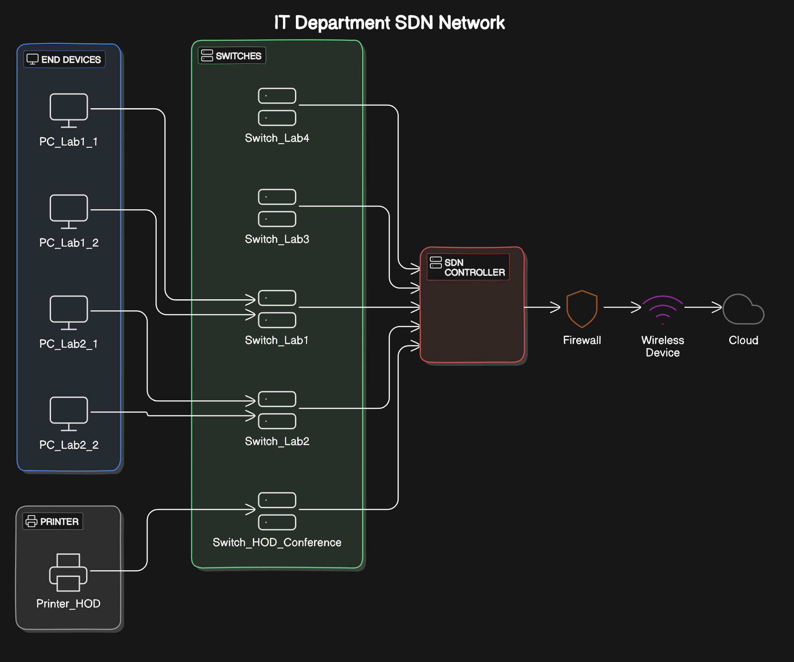
Architecture Diagram

Slide 9
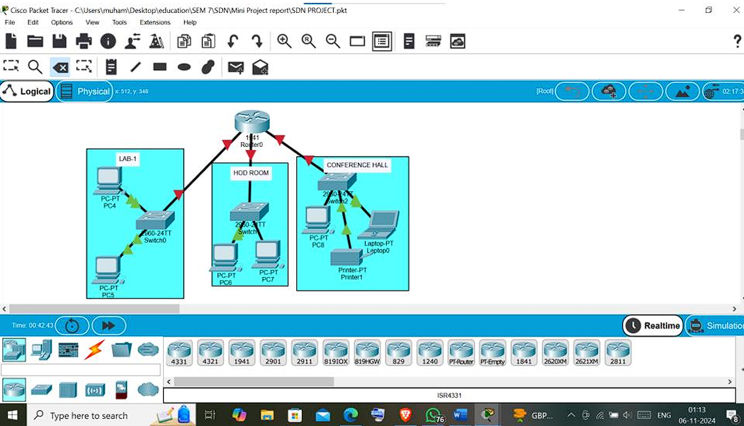
Topology Structure

Slide 10
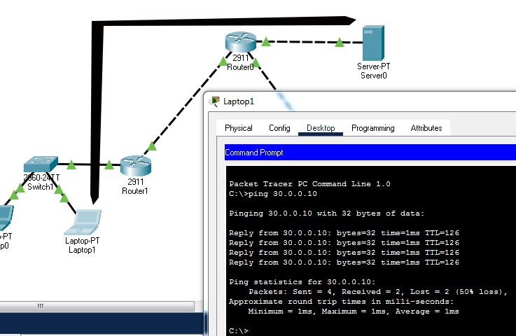
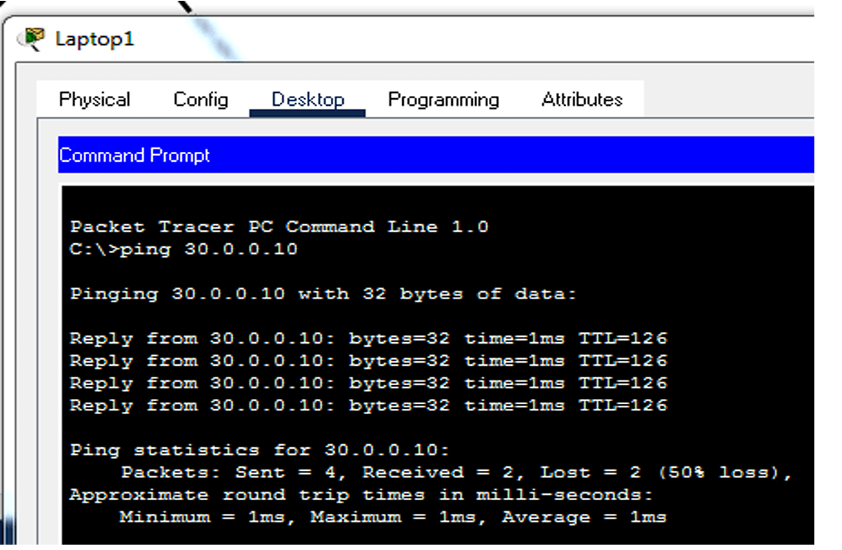
Results

Slide 11
REFERENCE
[1] H. Kim and N. Feamster, "Improving network management with software defined networking," IEEE Communications Magazine, vol. 51, no. 2, pp. 114-119, 2013. doi: 10.1109/MCOM.2013.6461195.
[2] Open Networking Foundation, Software-Defined Networking: The New Norm for Networks, 2012. [Online]. Available: https://opennetworking.org/sdn-resources/sdn-definition
[3] T. Benson, A. Akella, and D. A. Maltz, "Network traffic characteristics of data centers in the wild," Proceedings of the 10th ACM SIGCOMM Conference on Internet Measurement, Melbourne, Australia, 2010, pp. 267–280. doi: 10.1145/1879141.1879175.
[4] A. Shalimov, D. Zimarina, A. Zuikov, V. Pashkov, and R. Smeliansky, "Advanced study of OpenFlow-based Software-Defined Networks," in Proceedings of the 9th Central and Eastern European Software Engineering Conference in Russia (CEE-SECR '13), Moscow, Russia, 2013, pp. 1–6. doi: 10.1145/2556610.2556627.

Slide 12

Thank you

